Slide 1
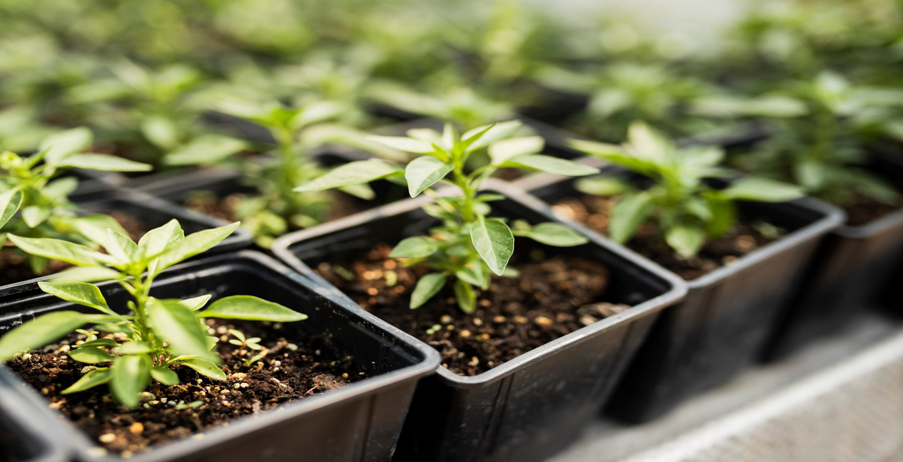
Nature
GreenNest
Fresh Greens Delivered
to your Doorstep

Slide 2
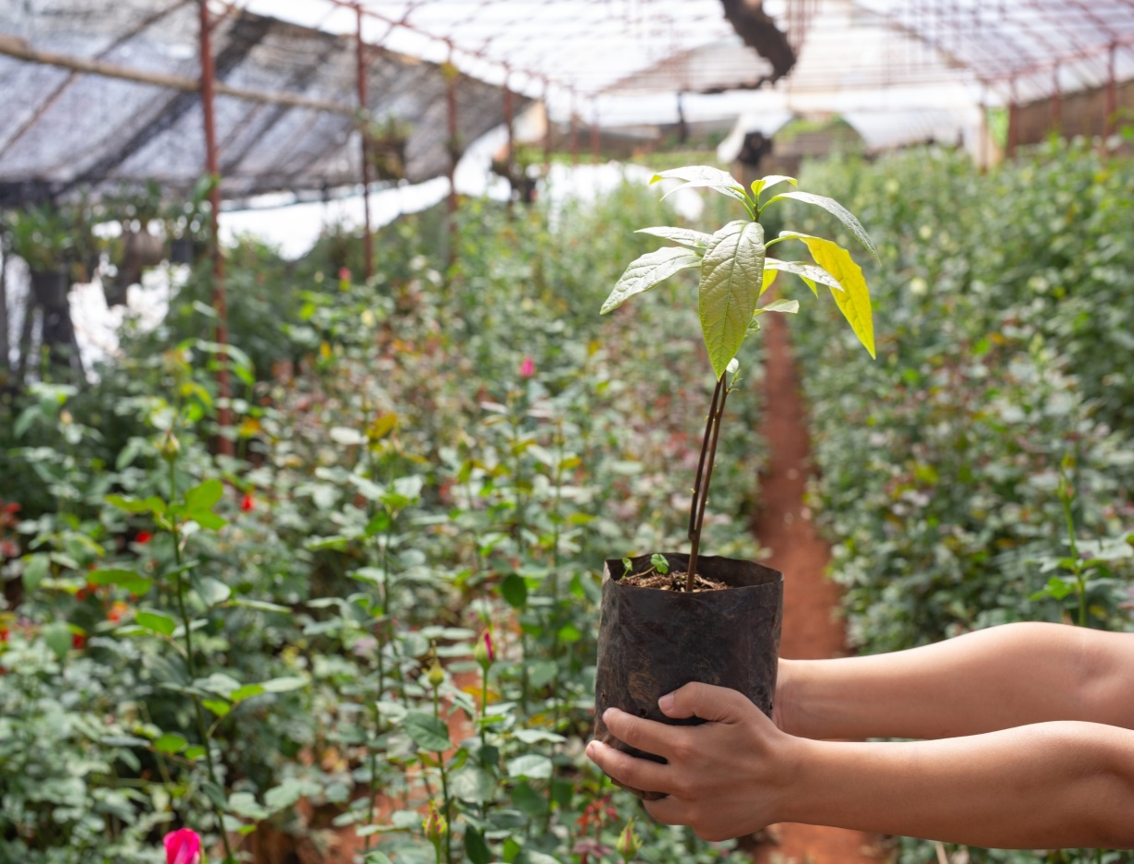
Mentor- Aditya Sabale Team Members
Group: D6
Himanshu_89301
Pratul_89803
Rishabh_89376
Vishal_89674

Slide 3
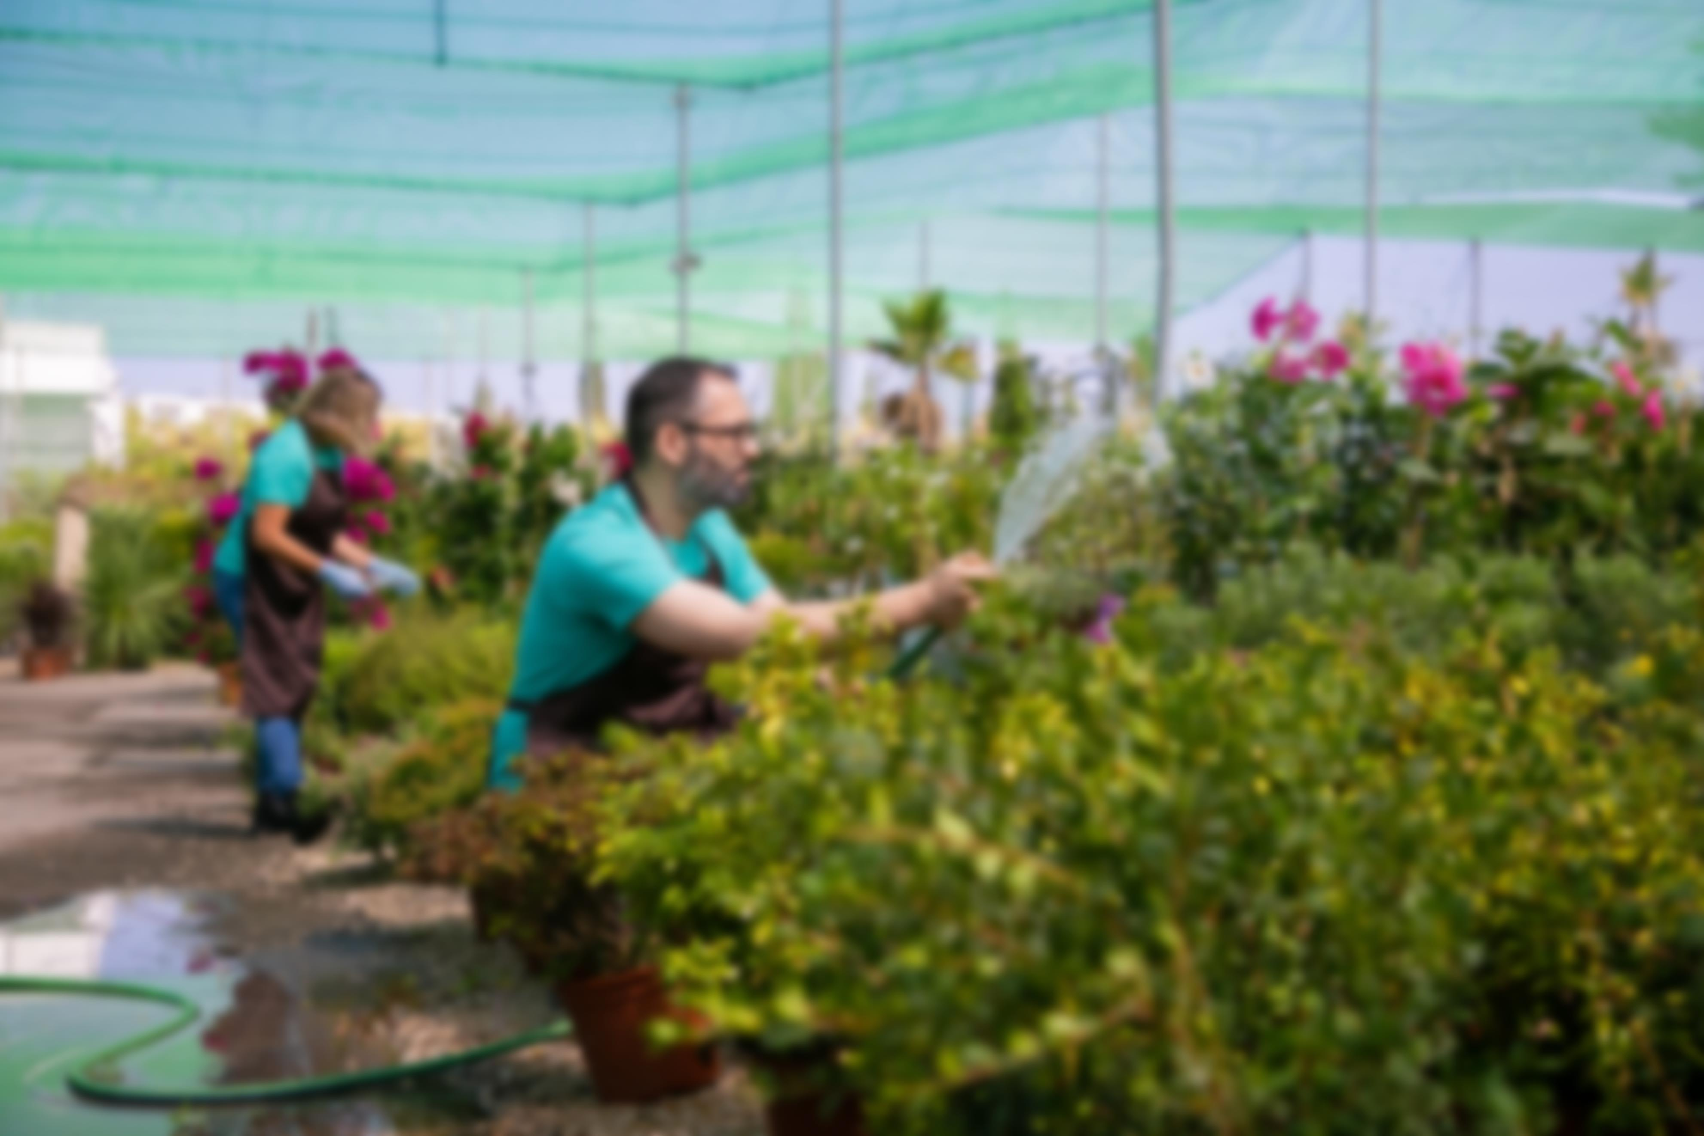
Abstract
In this project, we propose online plant shopping known as GreenNest which allows consumers to directly buy goods or services from seller over the internet using a web browser. The range of plants and garden products (including any installment of the goods or any parts for them) which are available for purchase fro our website in accordance with the terms. An agreements for us to sell you goods is made on these terms when we accept an order made by you via our website. We will confirm acceptance of your order on-screen.

Slide 4
Introduction
This project is a web based shopping system for an existing shop. The project objective is to deliver an online shopping application. Online shopping fasten process whereby consumer directly buy goods or services from a seller in real-time, without an intermediary service, over the Internet. It is a form of electronic commerce. This project is an attempt to provide the advantage of online shopping to customers of a real shop. It helps buying the products in the shop anywhere through internet. Thus the customer will get the service of online shopping and home delivery from his favorite shop.

Slide 5
Proposed system & its advantages:
Finding a plant online is much easier than looking for the local store.
It is easier to find rare plants Shopping online is very fast in buying rare plants
Plants are often more inexpensive. Plants are often cheaper online than they are in stores. There are several reason for this.
Save time and energy. You don’t have to waste your time going to stores, dealing.

Slide 6
Existing System & It’s Disadvantage:
The main disadvantage of online shopping is that there is an instant gratification. Because the item must be shipped to you, you will have to wait a few days.
As previously mentioned, many of the disadvantages of online shopping stem from shipping. Shipping charges and delays are both common problems.
Sometime you may face delivery risks. This means that the seller might fail to deliver the specified product or it deliver a product that has been damaged during shipping.

Slide 7
Why Plants?
Benefits of indoor and outdoor plants:
Air purification
Stress reduction
Home decor
Growing trend in plant ownership (especially post-pandemic)

Slide 8
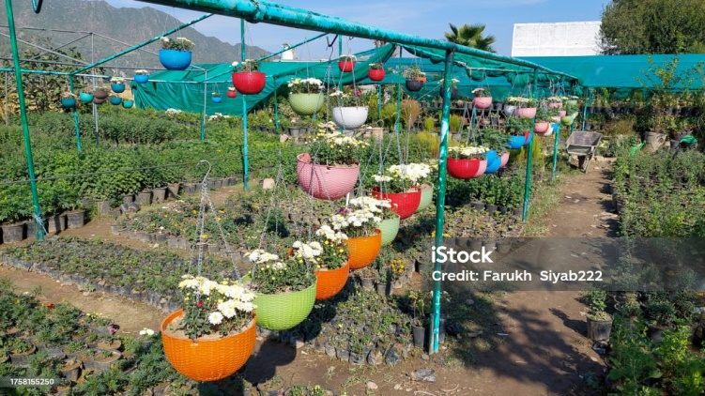
What We Offer
Categories:
Indoor plants
Outdoor plants
Succulents and cacti
Pots & accessories
Care products
Subscription plans or bundles

Slide 9
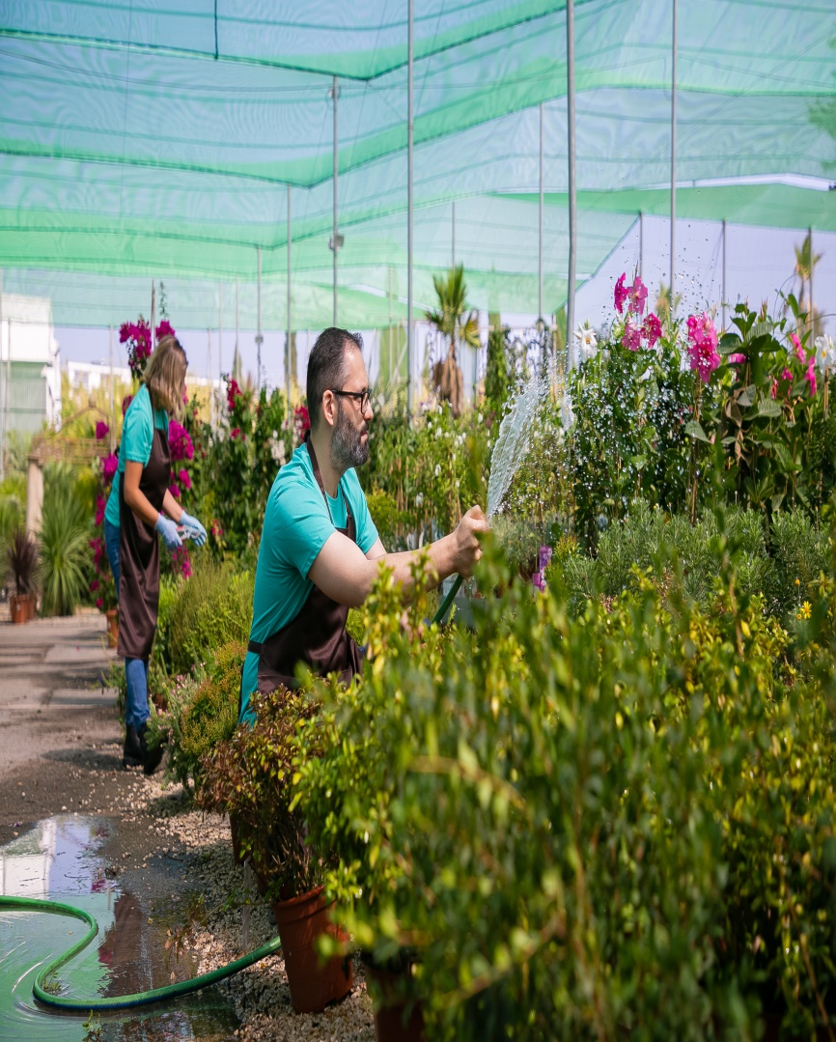
How It Works
Step-by-step order process:
Browse & choose plants
Add to cart & checkout
Fast delivery
Post-purchase care tips/support

Slide 10
Unique Selling Points (USP)
Healthy, pest-free plants guaranteed
Eco-friendly packaging
Personalized recommendations
Plant care guidance via blog/chat

Slide 11
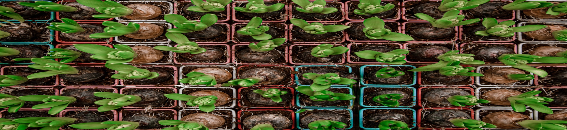
Target Market
Urban dwellers
Office workers
Plant lovers / hobbyists
Gifts & events market

Slide 12
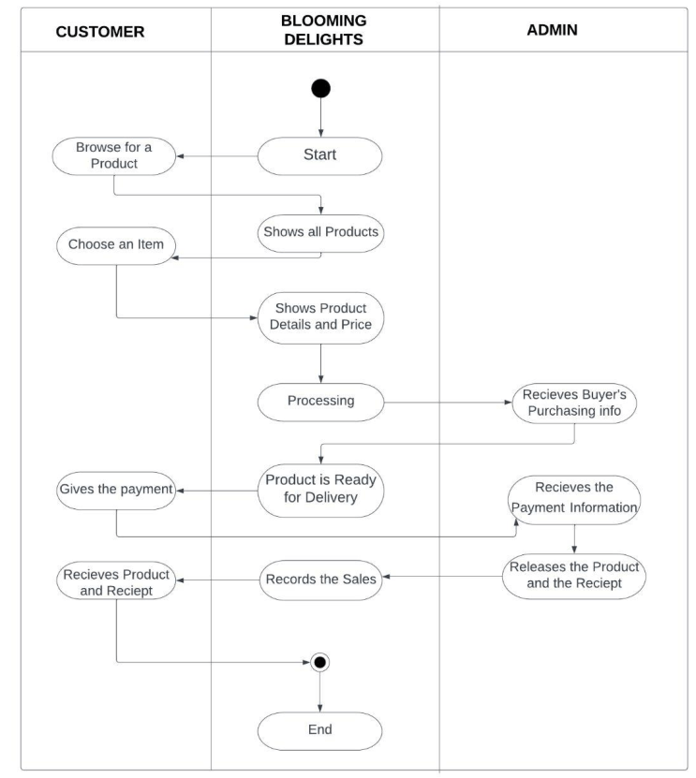
Flow Diagram

Slide 13
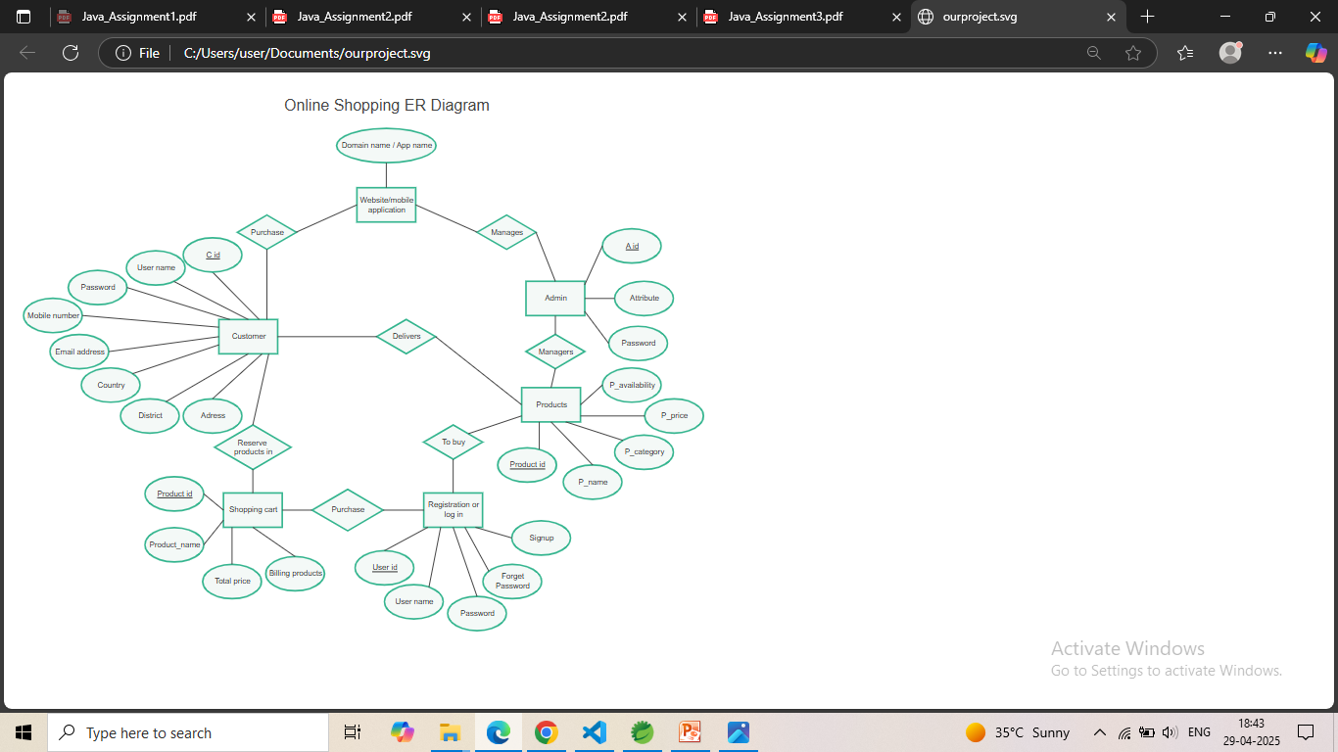
ER Diagram

Slide 14
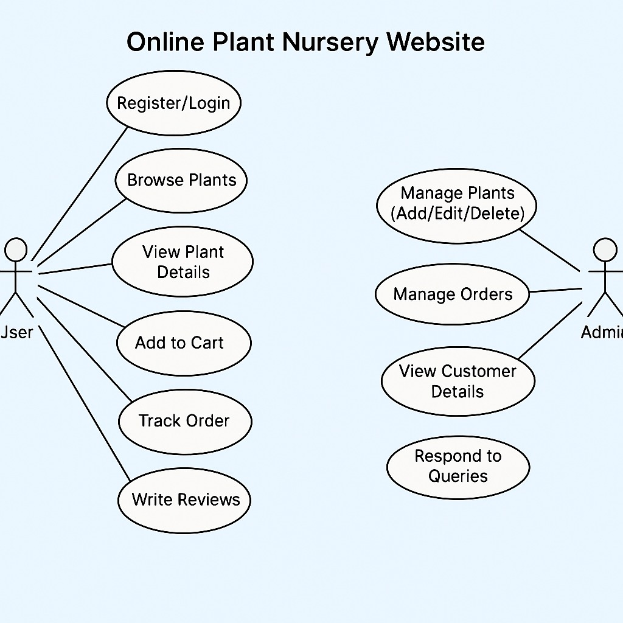

Slide 15
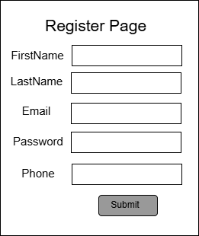

Slide 16
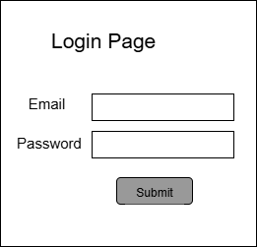

Slide 17
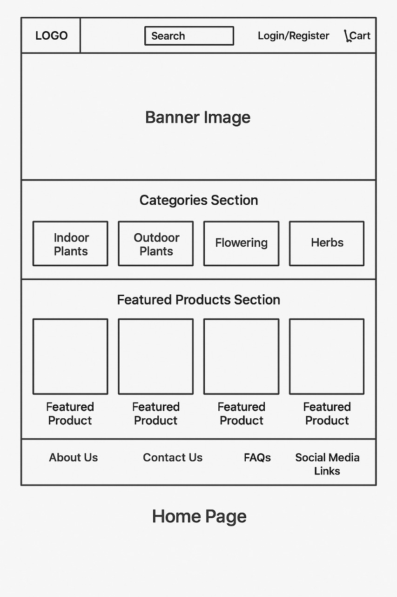

Slide 18
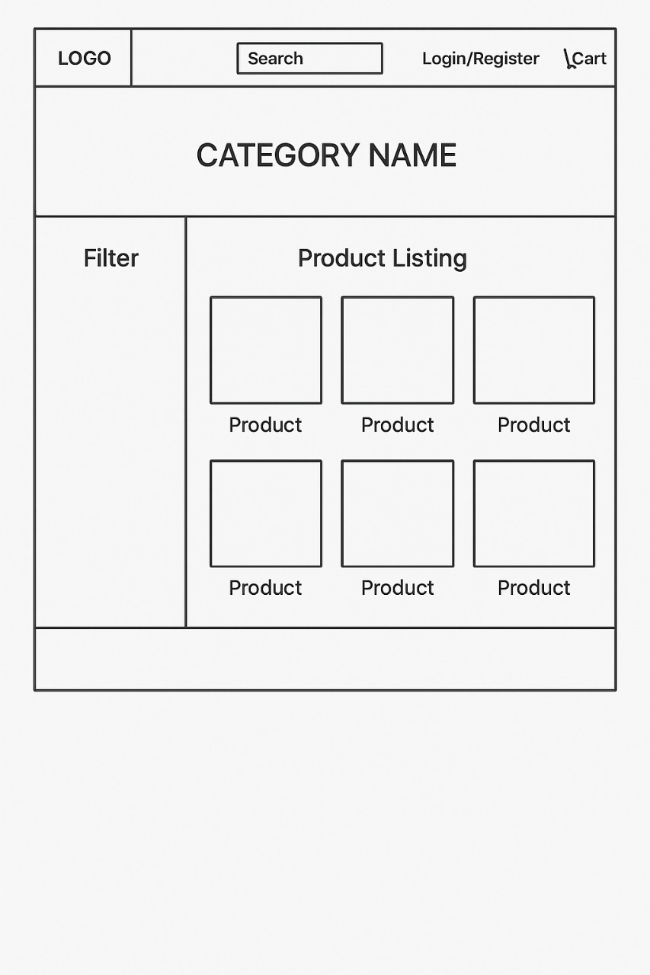

Slide 19
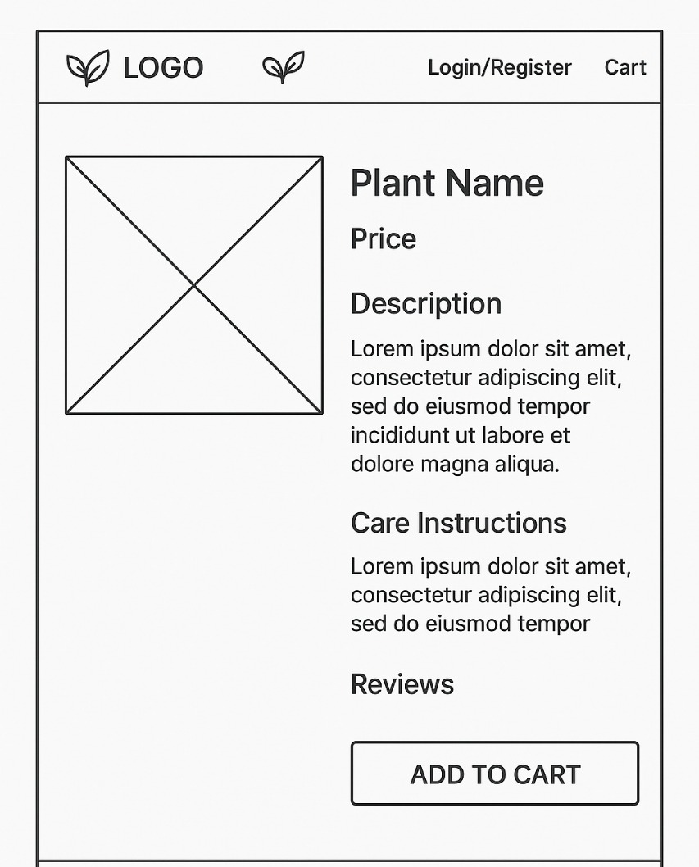

Slide 20
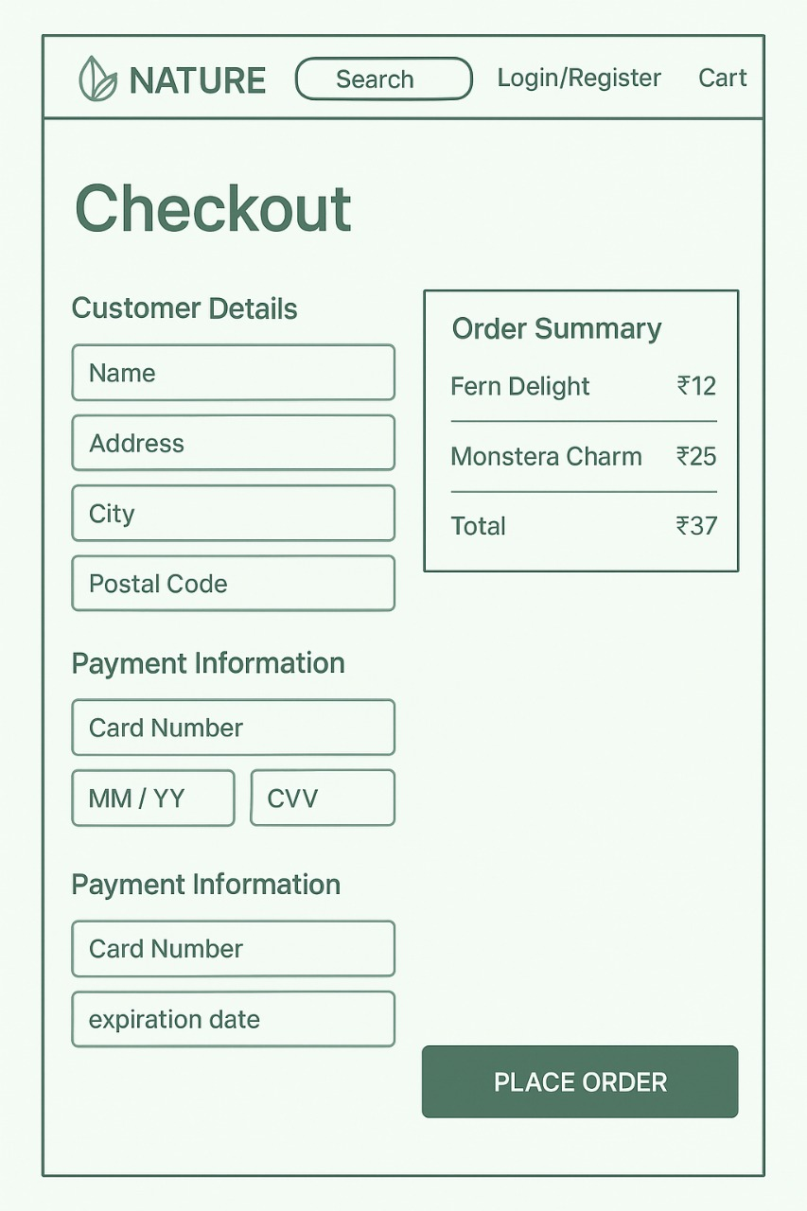

Slide 21
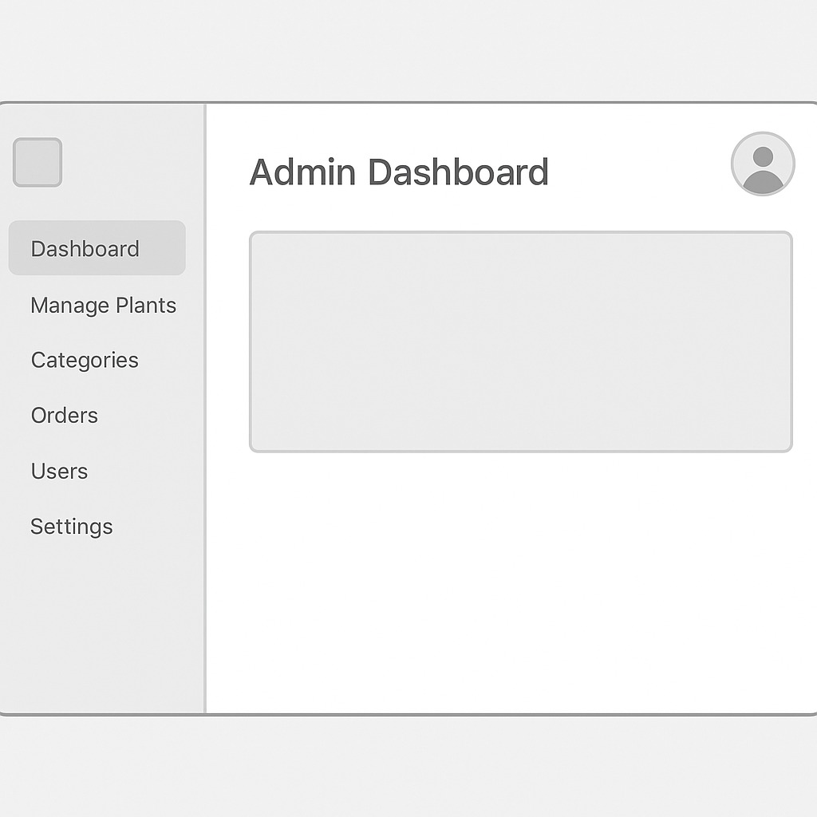

Slide 22
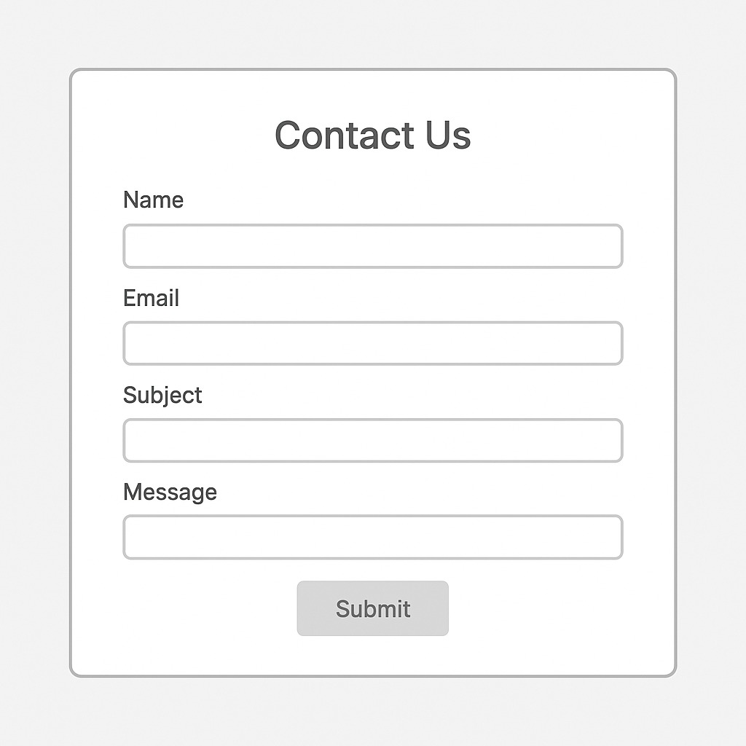

Slide 23
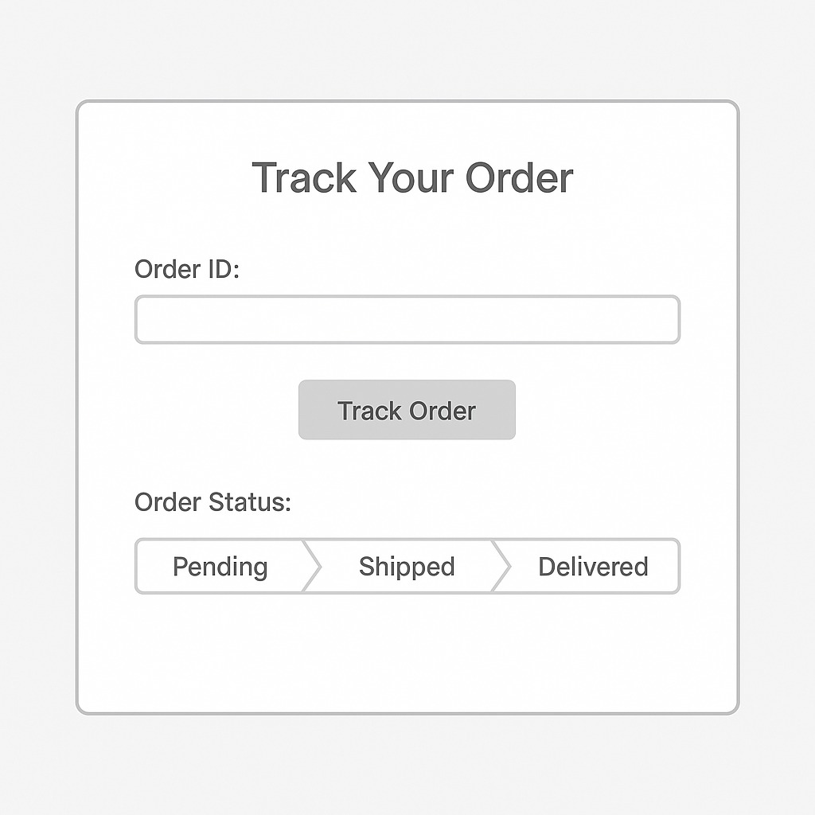

Slide 24
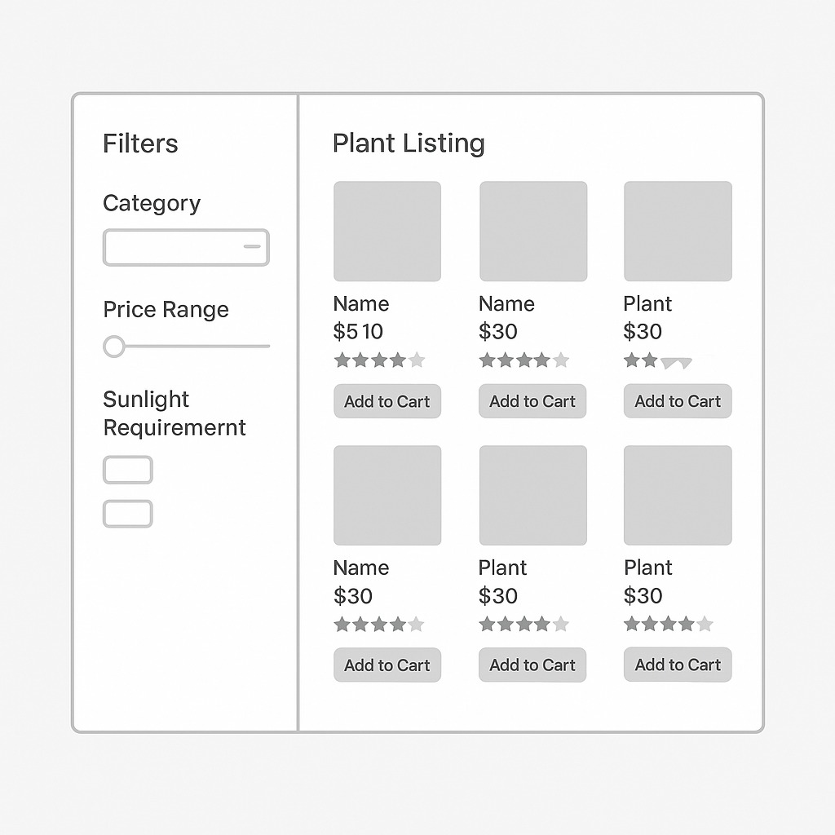

Slide 25
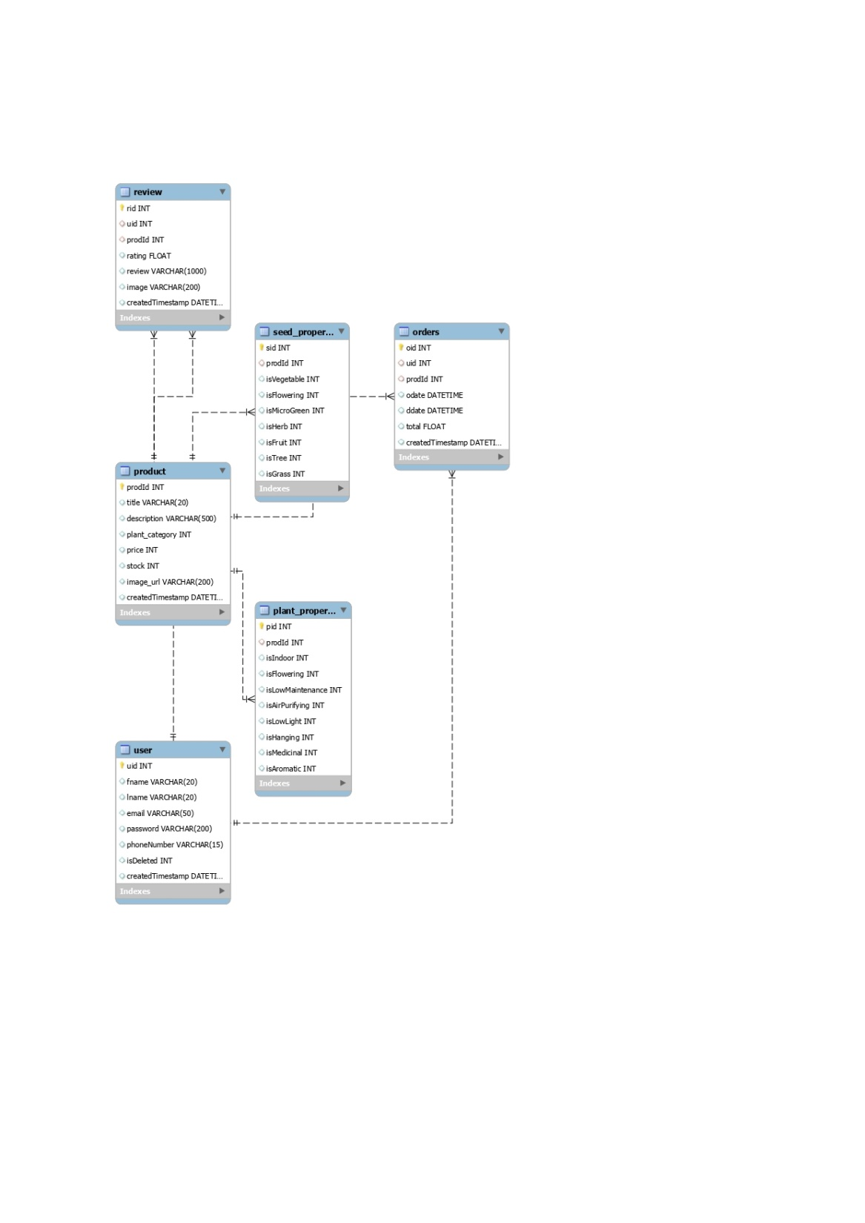

Slide 26


